Slide 1




Trainer- Anubhav Oberoy

Slide 2


SAP Signavio Training
Anubhav Oberoy
Day-2

Slide 3
Agenda Unit-2
Business Process Management Basics
Process Identification
Process Discovery
Process Analysis
Process Redesign
Process implementation and change management Redesign
Process monitoring and controlling

Slide 4





































Slide 5
UNIT:2- BPM Fundamentals
2:1-Business Process Management Basics
Notes:
https://unsplash.com/photos/L0nipfx-Ry4

Slide 6

Training Overview
1
2
BPM FUNDAMENTALS
Introduction
BPM
Fundamentals
2.1 Business Process Management basics
3
4
2.2 Process identification
Analyze and Enhance
Design
2.3 Process Discovery
5
From Build
To Enablement
2.4 Process Analysis
2.5 Process Redesign
6
2.6 Process implementation and change
management Redesign
Continuous Improvement
2.7 Process monitoring and controlling

Slide 7



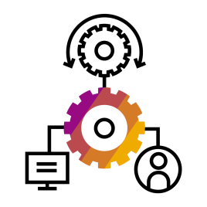
Business Process Management basics
Why BPM in this course?
Yields
Information Technology
Business Value
Process Change
Index Group (1982)

Slide 8





Business Process Management basics
Why should companies even care about BPM?
Increase Customer Satisfaction
Increase Productivity & Efficiency
Transformation
Increase Standardization & Ensure Scalability
Manage Compliance
Enable Agility

Slide 9






Business Process Management basics
Basic definitions – Business process
“Business processes are events, activities & decisions involving multiple actors and resources, that collectively lead to an outcome that is of value to an organization or its customers.”
(Dumas, Marlon, et al. 2013)
Input
Process
Output

Slide 10
Business Process Management basics
Basic definitions – Business Process Management
“Business Process Management is the art and science of overseeing how work is performed in an organization to ensure consistent outcomes and take advantage of improvement opportunities.”
(Dumas, Marlon, et al. 2013)
As Gartner puts it, “BPM brings attention to the highest-value processes – the ones that are most aligned with the business goals and strategy – for the best return on investment.”

Slide 11






Business Process Management lifecycle
Business Process Management basics
Process IDENTIFICATION
Process architecture
What is BPM?
What is BPM not?
Conformance and performance insights
As-is process model
A journey
Process
DISCOVERY
A project
It is about people
About the numbers
Business Process
Creates one language
Process MONITORING & CONTROLLING
Process
Only understood by experts
Management Lifecycle
ANALYSIS
Integrates all stakeholders
Executable process model
Insights on weaknesses and their impact
Exclusion of certain employees
Needs to fit into the organizational context
Should not follow a cookbook approach
Process IMPLEMENTATION
Process
REDESIGN
To-be process model
Source: Dumas, M., La Rosa, M., Mendling, J., Reijers, H: Fundamentals of Business Process Management, 2013

Slide 12
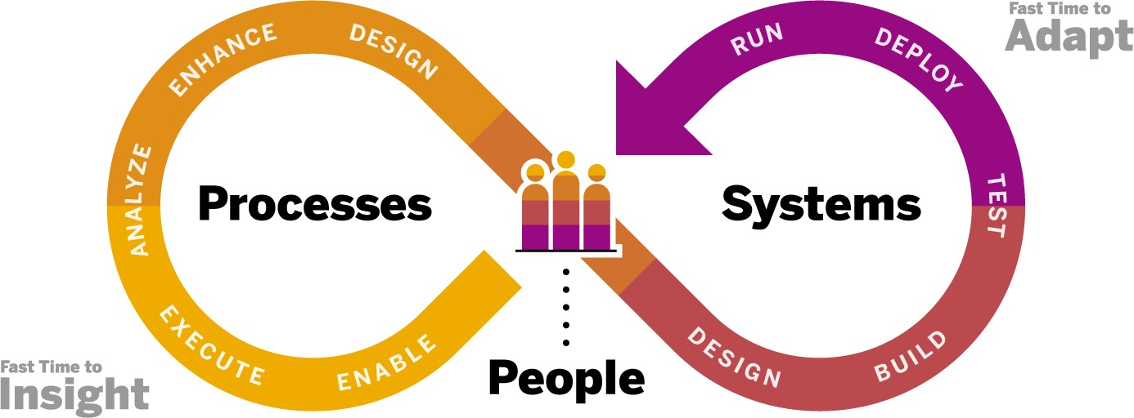
Business Process Management basics
SAP Signavio end-to-end business process transformation methodology

Slide 13

Success factors
Business Process Management basics
Set your company up for the BPM journey, not a project
Keep the focus on processes rather than on technology
Ensure management attention and sponsorship
Identify and focus on topics/processes of priority
Keep a sense of pragmatism

Slide 14


UNIT:2- BPM Fundamentals
2.2: Process Identification

Slide 15

Recap: Business Process Management basics
Process identification
In our previous unit you learned …
How and why transformations are a chance to
change processes and improve them continuously
Some of the advantages of BPM
The basic terms of BPM
The concept of the BPM lifecycle
Some of the critical success factors for BPM

Slide 16




BPM lifecycle phase explanation
Process identification
Process identification
Identify an organization’s processes and their relationships
Represent processes and their relations in an
architecture
Output: process architecture as a framework for modeling, analysis, and redesign
Process
IDENTIFICATION
Process architecture
Conformance and performance insights
As-is process
model
Process DISCOVERY
Process MONITORING & CONTROLLING
Business Process Management Lifecycle
Process
ANALYSIS
Executable process model
Insights on weaknesses and their impact
Process IMPLEMENTATION
Process
To-be process model
REDESIGN

Slide 17



Related governance topics
Process identification
Process Landscape & Levels
How to design the landing
page (process map)
Which approach to choose? (functional vs operational)
Organizational Setup & Roles
How to set up a BPM
organization?
Which roles to define?
Training & Enablement
What are meaningful trainings
for the different roles?

Slide 18

Process identification
Process level concept
Value chain diagrams
Level 1
Value chain
…
…
…
…
…
…
Level 2 Process areas / scenarios
Level 3
Business processes
BPMN 2.0
Level 4
Sub processes
* The level concept can include up to six levels. The level concept can also start from Level 0.

Slide 19

Process identification
Process architecture
Process (end-to-end) view and functional (capability) view need to match at the level of modular processes
The combined picture enables the business user to consistently navigate by activity or role description
End-to-end processes and journeys (operations view) Operating model (functional view)
Idea to Market Lead to Cash …
Source to Pay Plan to Fulfill …
Sales
Supply Chain Management
Finance
R&D / Engineering
Map
Marketing
Sourcing & Procurement
Manufacturing
…
Source to Pay
Procure to
Receipt
E2E Function
Sourcing & Procurement
Source to
Contract
Invoice to
Pay
Planning &
Sourcing
Procurement
Supplier
Management
…
Invoice to Pay
Planning & Sourcing
Value Step
Category
Process

Slide 20



Process identification
BPM organizational setup
Decentral approach
A small center of excellence of a team of process experts who collaborate closely with the business and process users
Central Approach
A large team of process experts who act as the process consultants on behalf of the lines of business

Slide 21






Common key roles (example)
Process identification
Process Owners
Process Experts / Process Manager
Chief Process
Officer
Process Council
Center of Excellence
Process User

Slide 22
Process identification
Training and enablement of key roles
Identification
Business Process Management (deep dive)
Understanding Lean Six Sigma
Discovery
How to execute process workshops
How to read and understand a process model
How to model and analyze processes
Analysis
Understanding process performance indicators
Interpreting process performance indicators
Redesign
Process improvement (simplification, automation, etc.)
Implementation
Leading change
How to communicate
Monitoring & Controlling
Leading continuous improvement
Process
IDENTIFICATION
Process architecture
Conformance and performance insights
As-is process
model
Process DISCOVERY
Process MONITORING & CONTROLLING
Business Process Management Lifecycle
Process
ANALYSIS
Executable process model
Insights on weaknesses and their impact
Process IMPLEMENTATION
Process
To-be process model
REDESIGN

Slide 23
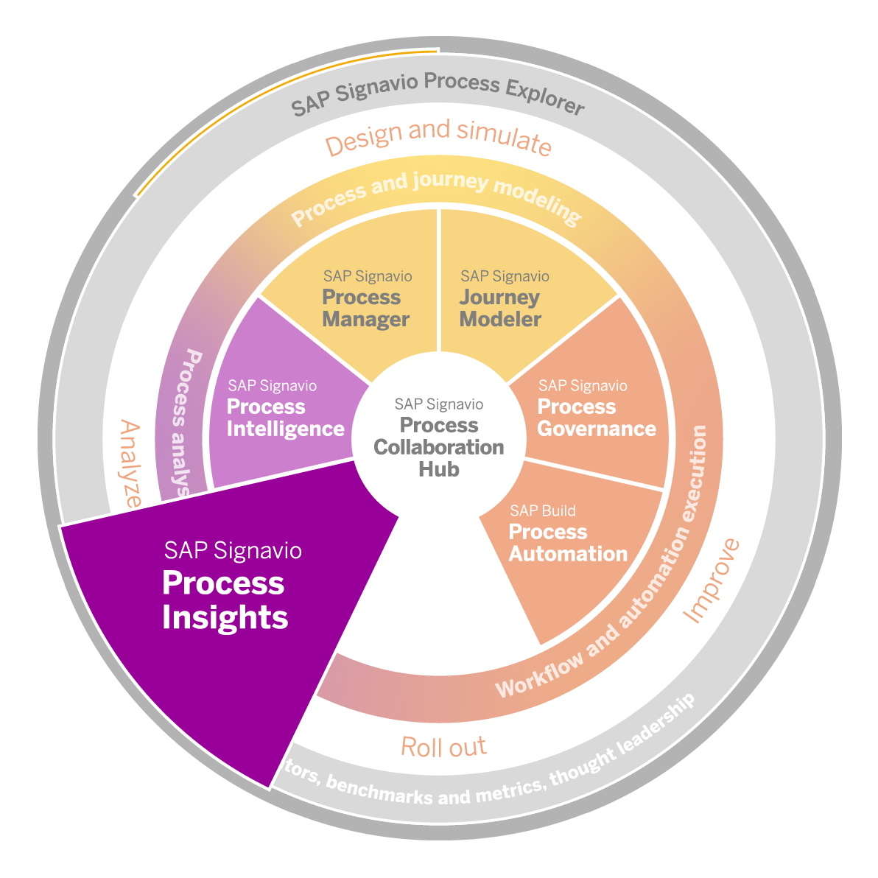
SAP Signavio solutions supporting process identification
Process identification
Process Explorer
Process Manager
Process Insights

Slide 24

Success factors
Process identification
Stay pragmatic and just get started
Follow one common approach and find the right level of detail
Be specific on process boundaries and scope
Clearly define responsibilities and ownership
Create an overview on critical governance elements

Slide 25
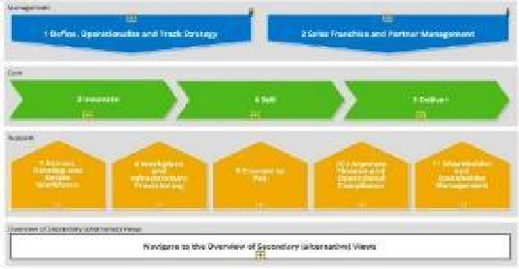
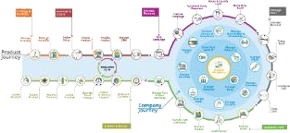
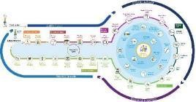
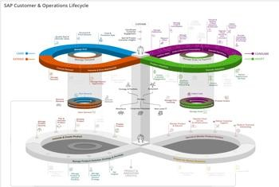
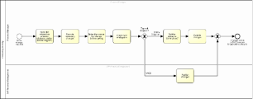
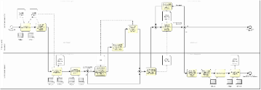
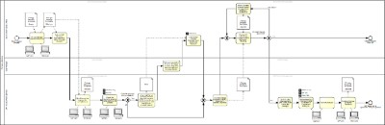
Process identification
BPM at SAP – Our journey with Signavio to drive our evolution of process management
Today: Cloud-ready and showcasing how development engages across the customer lifecycle with integrated process performance measures
Past:
Process map along board areas
Incorporation of E2E process view
based on SAP’s product lifecycle
E2E process lifecycle for internal operations and customer interaction
Process Map
2015
2018
2019-20
2021+
Process Diagrams
Beginning: Process diagrams with:
Process
Roles
Next evolution: E2E processes based on 4D:
Today: E2E processes with 4D+:
Process
Roles
Applications
Data
Process
Roles
Applications
Data
Process maturity
KPIs/PPIs
Business capabilities

Slide 26
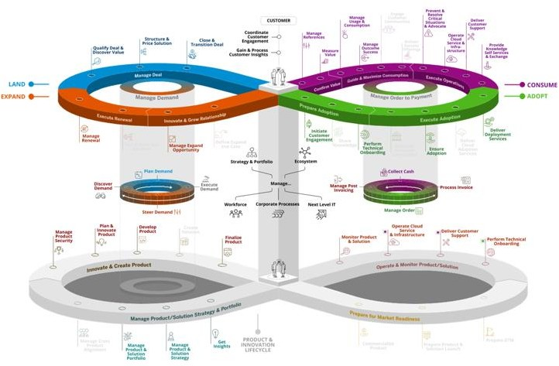
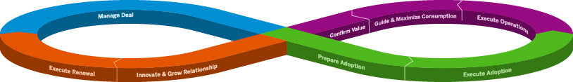


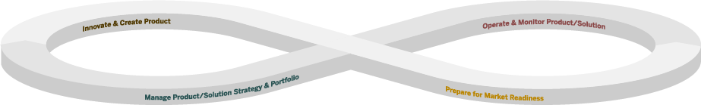


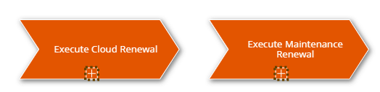
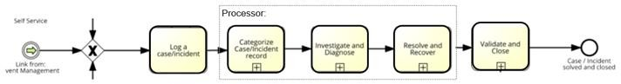
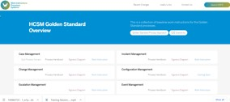
Process identification
BPM at SAP – Key concept of process levels
LEVEL
0
Process Area
1
Core Process
Business Architecture
(Strategic Processes)
(Node)
Value Chain Example Only:
2
Level 2.1 – 2.n
Value Chain
3
Level 3.1 – 3.n
Process Architecture
(Operational Processes)
Business Process
4
Log a case/incident
Activity
5
Work Instruction

Slide 27
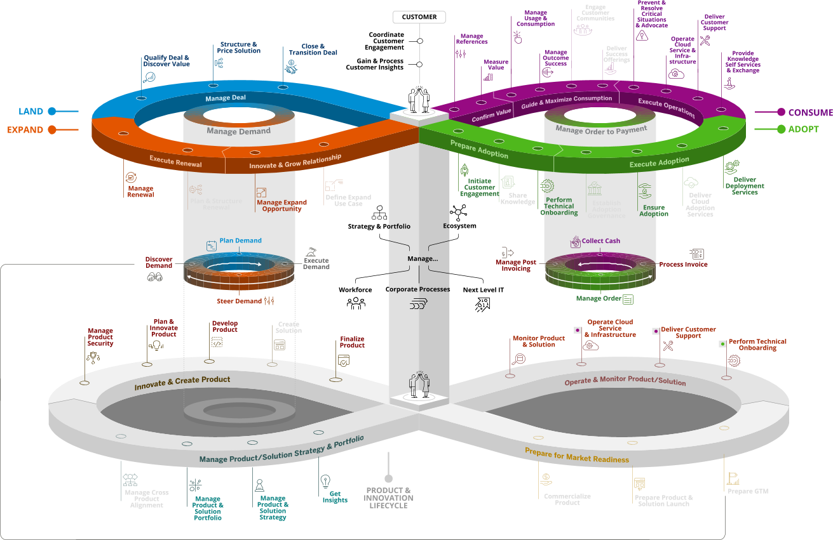
BPM at SAP – SAP customer and operations lifecycle
Process identification

Slide 28

UNIT:2- BPM Fundamentals
2.3: Process Discovery

Slide 29
Recap: Process identification
Process discovery
In our previous unit you learned …
The elements of process identification
The most important governance topics to consider during process identification
Design of a process architecture incl. a consistent level concept
Setting up a BPM organization
Definition of key roles
Training effort to be considered for such roles
Some of the critical success factors for process
identification

Slide 30

BPM lifecycle phase explanation
Process discovery
Process Discovery
Discover and capture the process
(via interview, workshop, or evidence)
Create process models
Output: as-is process model reflecting the
actual business process
Process
IDENTIFICATION
Process architecture
Conformance and performance insights
As-is process
model
Process DISCOVERY
Process MONITORING & CONTROLLING
Business Process Management Lifecycle
Process
ANALYSIS
Executable process model
Insights on weaknesses and their impact
Process IMPLEMENTATION
Process
To-be process model
REDESIGN

Slide 31



Most common approaches to discover processes
Process discovery
Interview
Conduct individual interviews
Create high level of trust
Identify different points of view
Workshop
Conduct collaborative process
discovery workshops
Identify different perspectives at once and discuss immediately
Evidence
Review existing
documentation
Analyze data reports
Perform shadowing

Slide 32
Process discovery
Process modeling
Process (end-to-end) view and functional (capability) view need to match at the level of modular processes
The combined picture enables the business user to consistently navigate by activity or role description
End-to-end processes and journeys (operations view) Operating model (functional view)
Idea to Market Lead to Cash … Sales
Supply Chain Management
Sourcing & Procurement
Finance
R&D / Engineering
Map
Source to Pay Plan to Fulfill … Marketing
Manufacturing
…
Source to Pay
Procure to
Receipt
E2E Function
Sourcing & Procurement
Source to
Contract
Invoice to
Pay
Planning &
Sourcing
Procurement
Supplier
Management
…
Invoice to Pay
Planning & Sourcing
Value Step
Category
Process

Slide 33
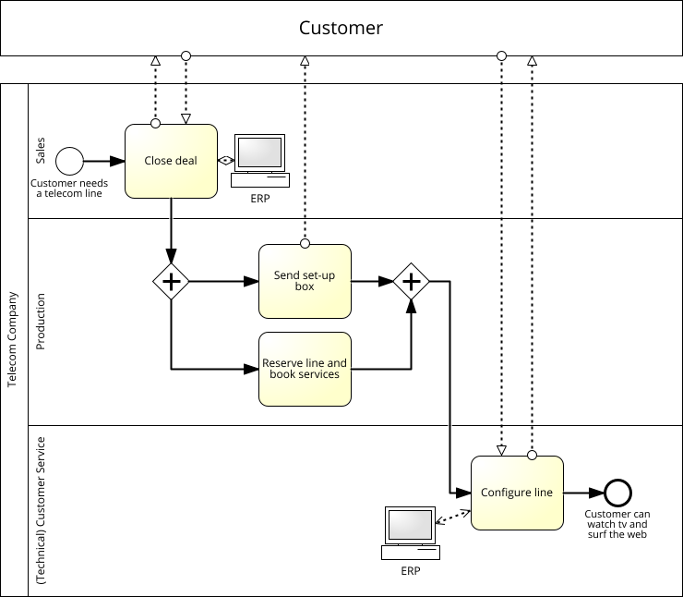
Business process models
Process discovery
Process models answer the following questions:
Responsibilities (who?)
Activities (what?)
Decision points (why?)
IT systems (where?)
Information flow (which data?)

Slide 34
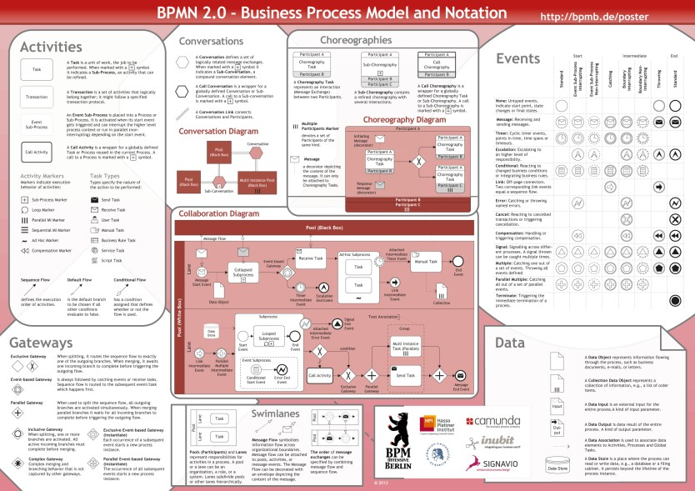
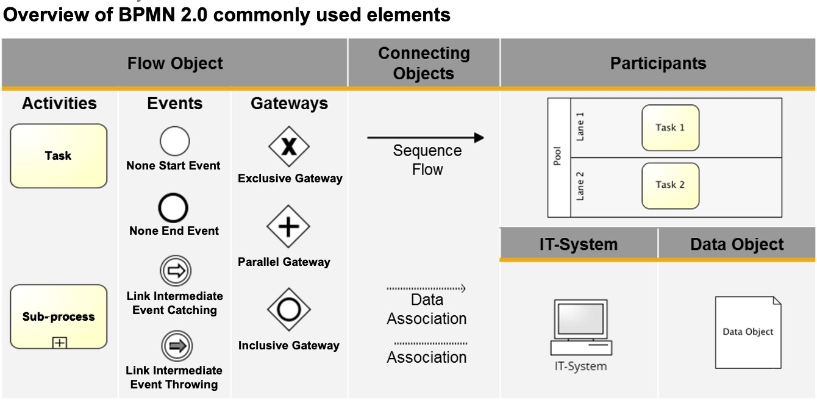
Process discovery
Modeling language – BPMN 2.0 (Business Process Model and Notation)
Complete set of objects of BPMN 2.0
Represent the process precisely and objectively
Provide a “common language” for stakeholders
Sub-set of most common objects of BPMN 2.0
Identify the objects really needed

Slide 35

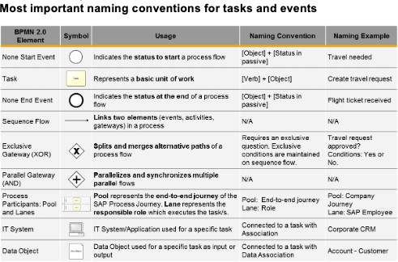

Process discovery
Modeling guidelines and conventions
Complete set of modeling conventions
detailing out the architecture, layout, naming, notation, and process structure
Sub-set of most common modeling rules
Summarize most important modeling rules and naming conventions in a cheat sheet

Slide 36

Journey modeling
Process discovery
Build a centralized view
by visualizing how your customers, agents, and
employees experience your business
Collaborate on experience
by making customer experience understandable and
accessible across the entire company
Gather unified knowledge of how processes affect experiences
by linking processes and insights to specific steps of
a journey

Slide 37
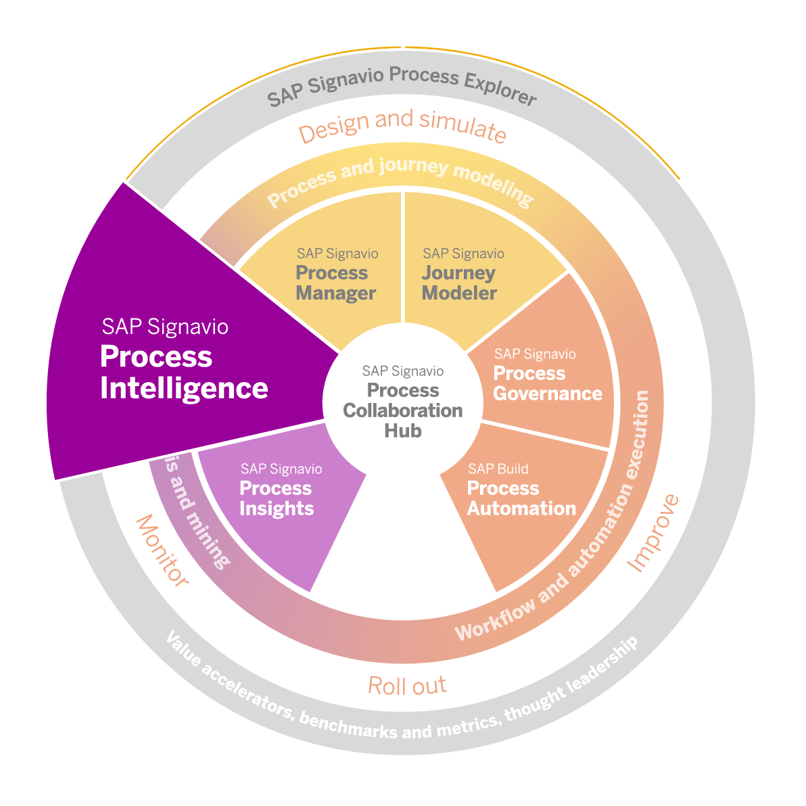
SAP Signavio solutions supporting process discovery
Process discovery
Process Manager
Journey Modeler
Process Collaboration Hub
Process Intelligence

Slide 38
Process discovery
Success factors
Leverage existing documentation before conducting interviews or workshops
Pay attention to data accuracy and leverage existing data sources
Remind yourself to focus on the as-is
Ensure availability and accessibility of important stakeholders
Consider taking on an outside-in view (to combine with inside-out view)
Verify common understanding of as-is process with important stakeholders

Slide 39







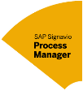
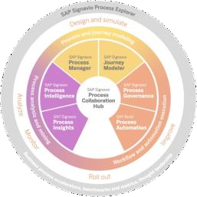


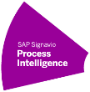

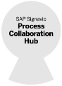
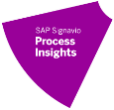
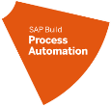
BPM at SAP – Process excellence through the golden standard for business processes
Process discovery
Methodologies, standards, and guidelines for optimizing our processes
GOLDEN Golden Standard ^{Standard} Process Excellence
4D map Methodology Process, Roles and People, IT Systems, Data | Standards & Guidelines Design Standards Modeling Guidelines Compliance Guardrails Enablement | 4D | Process Continuous Performance Improvement Process Maturity ▪ User Feedback KPI and PPI ▪ Improvement Potential Business Capabilities ^{and Recommendations} _{Process Mining} ▪ Process Performance Assessment Annual Process Reviews
map
Standards &
Methodology Guidelines
Process, Roles and • Design Standards
People, IT Systems, Data
Modeling Guidelines
Compliance Guardrails
Enablement

Slide 40






Process discovery
BPM at SAP – 4D map methodology
Apply 4 “DIMENSIONS”… in “ONE VIEW”
Roles
Process
what is done
Data
Role
who is doing
4D
in
out
IT System
what is used
Processes
map
Data
what data comes in/out
Systems & Applications
Improving end-to-end process integration via the 4D map helps model the process in a holistic manner and utilize the modeling tool in the best possible way.

Slide 41

UNIT:2- BPM Fundamentals
2.4: Process Analysis

Slide 42
Process analysis
Recap: Process discovery
In our previous unit you learned
The elements of process discovery
The most important governance topics to consider during process discovery
Process modeling conventions
Including a defined set of BPMN 2.0 objects
Journey modeling
SAP Signavio products to support process discovery
Some of the critical success factors for process identification

Slide 43
Process analysis
BPM lifecycle phase explanation
Process analysis
Identify inefficiencies, redundancies, and other issues impacting efficiency
Apply qualitative and quantitative techniques to analyze process
Output:
as-is process model reflecting the actual business process
process weaknesses identified
Process
IDENTIFICATION
Process architecture
Conformance and performance insights
As-is process
model
Process DISCOVERY
Process MONITORING & CONTROLLING
Business Process Management Lifecycle
Process
ANALYSIS
Executable process model
Insights on weaknesses and their impact
Process IMPLEMENTATION
Process
To-be process model
REDESIGN

Slide 44
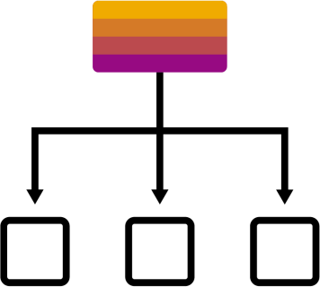


Process analysis
Qualitative techniques to analyze process
Value Stream Mapping
Lean manufacturing technique to visualize and analyze the flow of materials, information, and activities required to produce a product or service
Focus on process optimization and customer satisfaction
Waste Analysis (7 Types)
Systematic examination of processes to identify areas of inefficiency, wastefulness, and non- value-adding activities
Goal is to identify and eliminate any activity or process that doesn’t create value for the customer
Root Cause Analysis
Aims to identify the underlying causes of problems, defects, or incidents in a process or system to prevent reoccurrence
Also called Ishikawa Diagram

Slide 45
























Slide 46
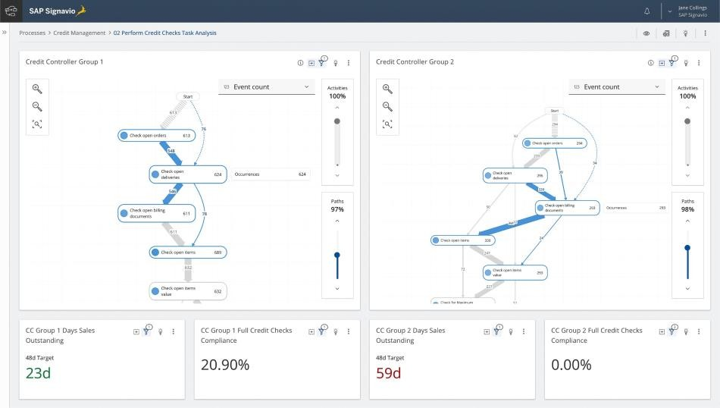
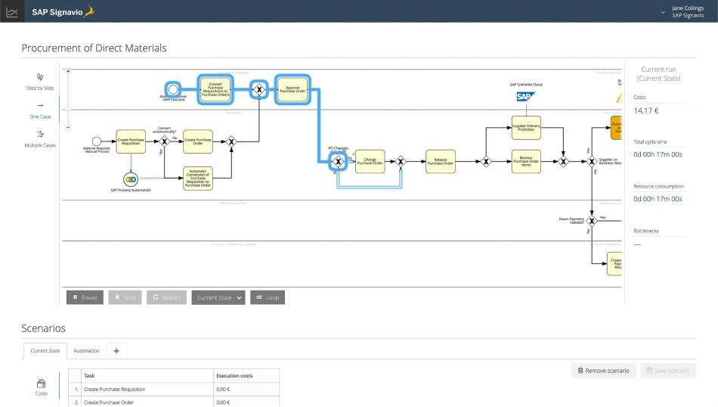
Process analysis
Quantitative techniques to analyze process
Process Mining
Visualize and analyze processes using data from event logs (in system-based processes)
Helps identify bottlenecks, inefficiencies, and
compliance issues objectively and instantly
Process Simulation
Simulate the behavior of a process under different scenarios or conditions
Evaluate the impact of changes before
implementing them in the real world

Slide 47

Prioritization of weaknesses
Process analysis
Common criteria for prioritizing weaknesses
and improvement measures
Customer / employee value
Financial benefit
Social / environmental impact
Implementation effort
Need for external support

Slide 48
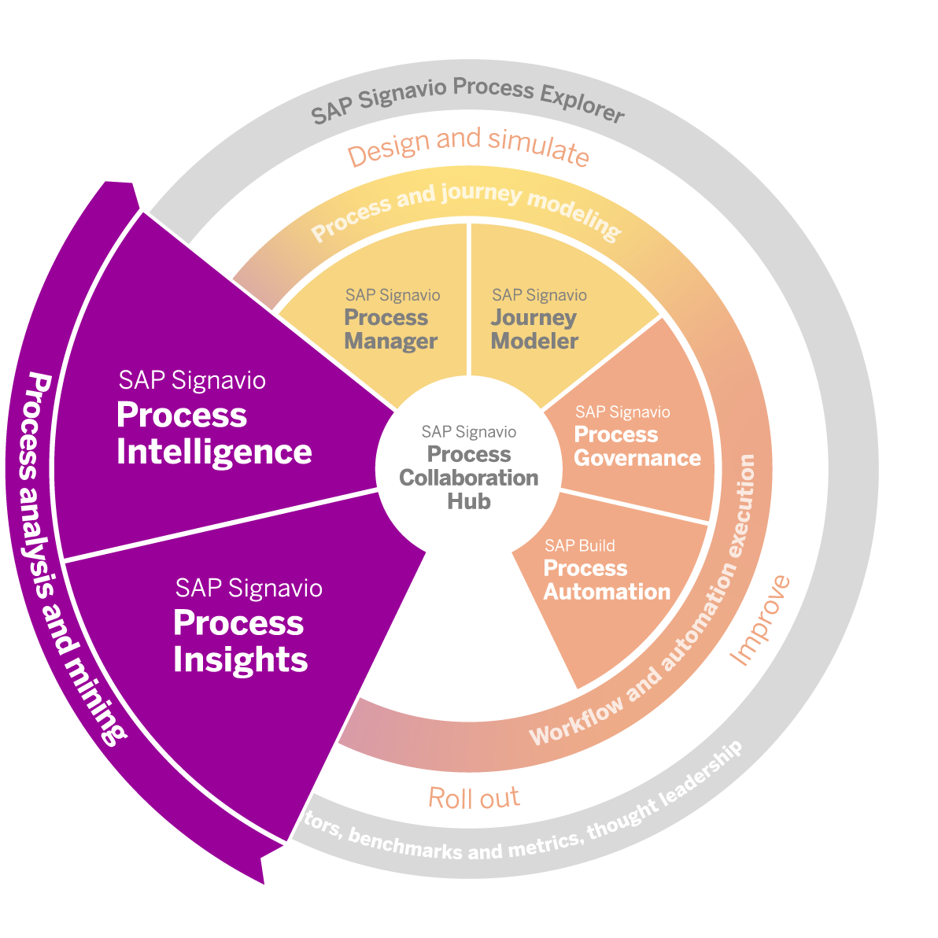
Process analysis and mining with SAP Signavio solutions
Process analysis
Understand how your processes actually run and identify improvement opportunities.
Built-in analysis of SAP ERP Central Component (SAP ECC) and SAP S/4HANA systems
Improvement recommendations
System-agnostic detailed process analysis and mining
Automated insights

Slide 49
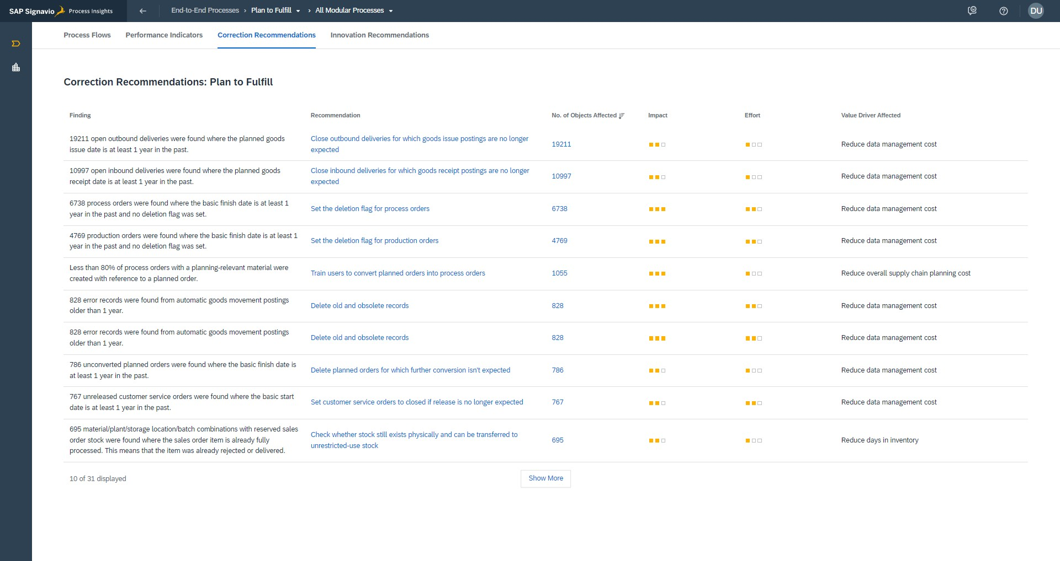
Process analysis
Process analysis and improvement recommendations with SAP Signavio Process Insights
Correction Recommendations

Slide 50
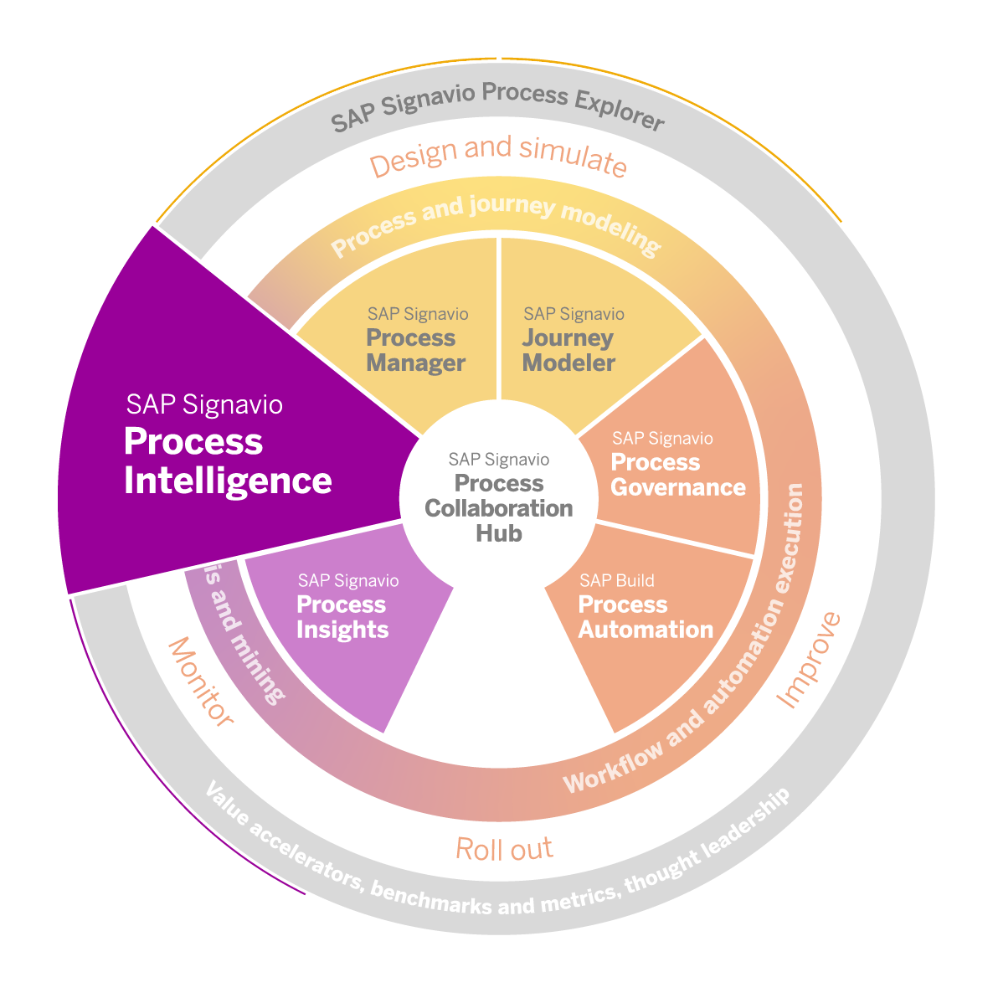
SAP Signavio solutions supporting process analysis
Process analysis
Process Manager
Journey Modeler
Process Insights
Process Intelligence

Slide 51
Success factors
Process analysis
Pay attention to data accuracy and completeness
Be prepared to face complexity identifying bottlenecks due to the interconnectedness
Ensure to identify the actual root causes of process problems
Prioritize process weaknesses wisely
Invest in enablement of process analysis techniques

Slide 52


UNIT:2- BPM Fundamentals
2.5: Process Redesign

Slide 53
Process redesign
Recap: Process analysis
In our previous unit you learned
The elements of process analysis
The most common process analysis techniques
Which elements of SAP Signavio Process Transformation Suite can support process analysis
Some of the critical success factors for process analysis

Slide 54
Process redesign
BPM lifecycle phase explanation
Process redesign
Improve the as-is process considering the identified weaknesses
Tradeoff between performance dimensions (time, quality, cost, flexibility)
Output: to-be process model reflecting the future status
Process
IDENTIFICATION
Process architecture
Conformance and performance insights
As-is process
model
Process DISCOVERY
Process MONITORING & CONTROLLING
Business Process Management Lifecycle
Process
ANALYSIS
Executable process model
Insights on weaknesses and their impact
Process IMPLEMENTATION
Process
To-be process model
REDESIGN

Slide 55

Process redesign
Performance dimensions of process redesign
AS-IS process model
TO-BE process model
Cost
Time
Flexibility
Quality

Slide 56

Process redesign
Process improvement approaches
Different change approaches may lead to process improvement
change of order 1 3 2 ▪ eliminate
1
2
3
improve/ accelerate
1
2+
3
outsource
1
2
3
automate
1
3
combine
1
2+3
4
2
reduce complexity
1-
2
3
parallelize
1
4
3
standardize
1
(2)
3
start earlier
0
1
2
3
make more flexible
1
- -2- -
3
extend
1
2
3
4

Slide 57

Process redesign
Business process automation
Business process automation (BPA) is the use of software and technology to automate business processes and functions to accomplish defined organizational goals (such as producing a product, hiring and onboarding employees, or providing customer service).

Slide 58
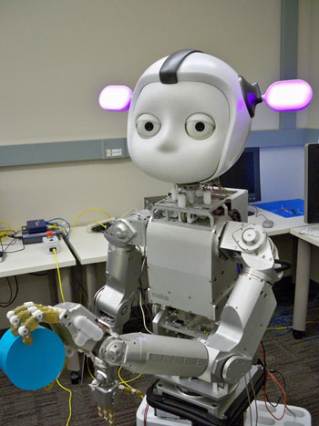

Robotic process automation
Process redesign
Robotic process automation (RPA) tools and bots are integrated into business systems for the purpose of automating and simplifying various tasks and interactions.
It describes software and bots that are programmed to emulate and copy human actions to complete repetitive business tasks.
RPA software robots can navigate systems, read and enter data, and perform a wide range of rule- based tasks.

Slide 59
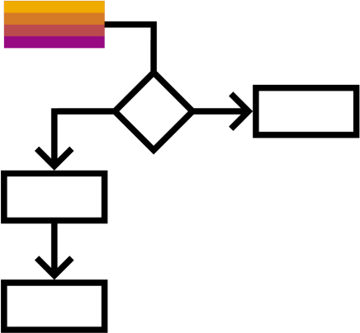
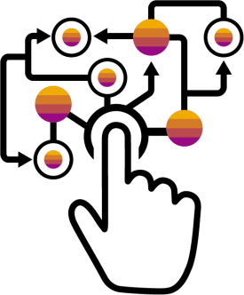
Workflow and workflow automation
Process redesign
A workflow
can be defined as a sequence of connected activities or tasks that are completed to achieve a particular result.
A structured workflow follows a distinct path, which may be sequential or parallel to meet specific dependencies or requirements.
Workflow automation
can be defined as making the flow of tasks, documents, and information across work- related activities perform independently in accordance with defined business rules.
It refers to specific tasks within an entire workflow.

Slide 60
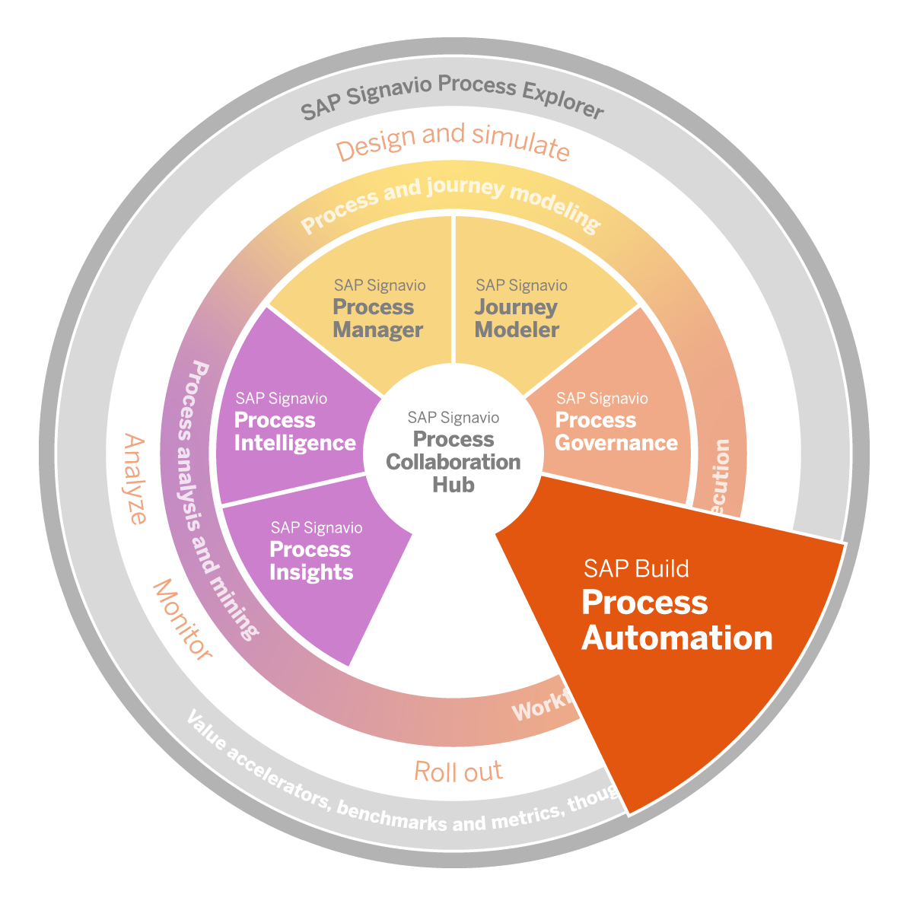
SAP Signavio solutions supporting process redesign
Process redesign
Process Manager
Process Collaboration Hub
Process Explorer
Process Automation

Slide 61
Success factors
Process redesign
Think out-of-the-box
Balance the critical criteria e.g. cost, time, quality, and flexibility
Invest in automation know-how and resources
Be inclusive when designing processes to meet important stakeholders‘ needs

Slide 62

UNIT:2- BPM Fundamentals
2.6: Process Implementation and Change Management

Slide 63
Process implementation and change management
Recap: Process redesign
In our previous unit you learned
The elements of process redesign
Examples of process improvement approaches
Which elements of SAP Signavio Process Transformation Suite can support process redesign
The high-level concept of automation
Some of the critical success factors for process redesign

Slide 64
BPM lifecycle phase explanation
Process implementation and change management
Process implementation
Prepare the to-be process for implementation
Identify and realize automation potential
Ensure strong change management and training around the process
Output: implemented to-be process and
educated and enabled stakeholders
Process
IDENTIFICATION
Process architecture
Conformance and performance insights
As-is process
model
Process DISCOVERY
Process MONITORING & CONTROLLING
Business Process Management Lifecycle
Process
ANALYSIS
Executable process model
Insights on weaknesses and their impact
Process IMPLEMENTATION
Process
To-be process model
REDESIGN

Slide 65
Implementation and rollout
Process implementation and change management

Slide 66
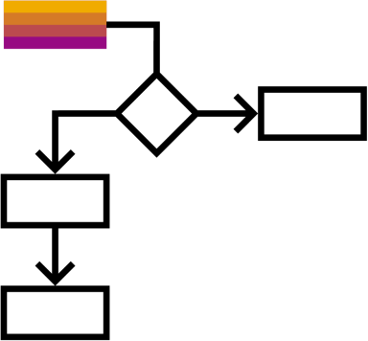


Implementation and rollout
Process implementation and change management
Process rollout
Deploy the new process across the organization and ensure that stakeholders have the necessary resources and support to execute it properly.
Systems implementation
Involves transitioning the system from development and testing to production.
Requires planning, testing, and coordination to ensure system is deployed with minimal disruption.
People
Prepare all affected stakeholders for the changes.
Ensure people are
enabled
equipped and
empowered

Slide 67



Change management
Process implementation and change management
The measure of intelligence is the ability to change.
Albert Einstein

Slide 68







Process implementation and change management
Change and the impact on operations
Change drivers…
…constantly challenge the way we operate
Operational efficiency
External factors
Market expansion
M&A, spin-offs, incubation
Business
model change
Client
expectation shifts

Slide 69
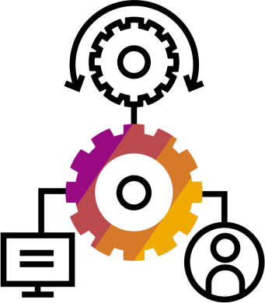

Process implementation and change management
Reaction to change
Denial
Disbelief about the change plan, look for evidence to deny the change plan
Communicate and inform
Integration
Adapted changes and new ways of doing things, a renewed individual
Morale
Frustration
Recognition that things will be changed, anger towards the change
Watch, listen, and support
Decision
Learning how to deal with the changed situations, feeling more positive about the change plan than before
Celebrate
Shock
Surprise or shock at the initial recognition of the change
Experiment
Initial engagement with the change process looking for justifications
Give time to explore and test
Depression
Low performance, lacking energy and motivation
Publication of change
Time
Kubler-Ross Change Curve

Slide 70






Process implementation and change management
Objectives of change management
Reduce Disruption
Minimize Resistance
Increase Employee Satisfaction
Manage Risk
Ensure Adoption
Enable Continuous Improvement

Slide 71
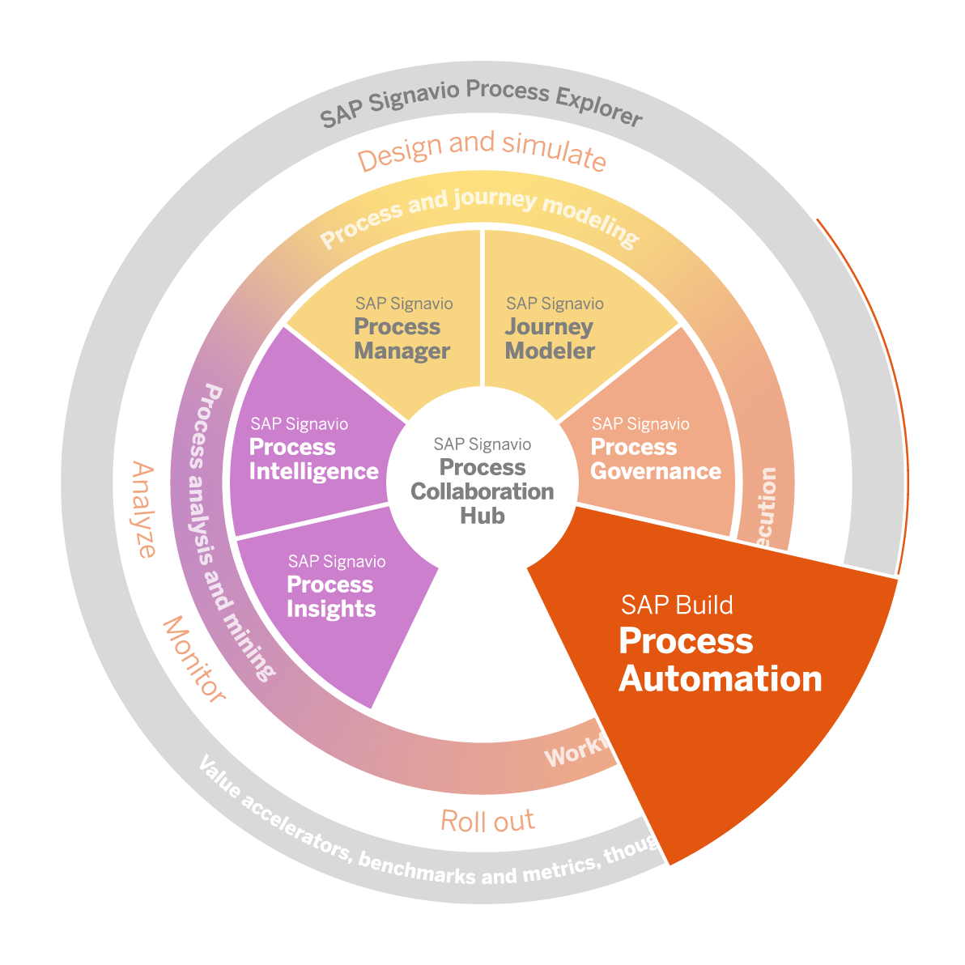
SAP Signavio solutions supporting process implementation and change management
Process implementation and change management
Process Collaboration Hub
Process Governance
Process Automation

Slide 72
Success factors
Process implementation and change management
Understand resistance to change from employees
Prioritize change management
Train and enable employees on new processes or tools
Plan in sufficient time for rollout and implementation effort
Foster process coherence

Slide 73

UNIT:2- BPM Fundamentals
2.7: Process Monitoring and Controlling

Slide 74
Process monitoring and controlling
Recap: Process implementation and change management
In our previous unit you learned
The elements of process implementation
Why change management is important
Which elements of SAP Signavio Process Transformation Suite can support process implementation
Some of the critical success factors for process implementation

Slide 75
Process monitoring and controlling
BPM lifecycle phase explanation
Process monitoring and controlling
Continuously observe the process performance to
evaluate if the change had the respective impact
detect new process issues early and react quickly
Fine-tune the process
Output: Improved and monitored process
Process
IDENTIFICATION
Process architecture
Conformance and performance insights
As-is process
model
Process DISCOVERY
Process MONITORING & CONTROLLING
Business Process Management Lifecycle
Process
ANALYSIS
Executable process model
Insights on weaknesses and their impact
Process IMPLEMENTATION
Process
To-be process model
REDESIGN

Slide 76
Process monitoring and controlling
Process monitoring and controlling
What is not defined, cannot be measured.
What is not measured, cannot be improved.
What is not improved, will always degrade.
William Thomson Kelvin

Slide 77

Process monitoring and controlling
Process performance management
Process performance management
The practice of measuring, controlling, and reporting on processes with the goal of achieving defined process objectives. It promotes effectiveness and efficiency by continuously improving processes.

Slide 78

Process monitoring and controlling
Objectives of process performance management
Enable process-oriented decision making
Establish a culture of continuous improvement by detecting improvement potential systematically
Perform fact-based and professional management of processes

Slide 79



Process monitoring and controlling
Process performance indicators – PPIs
Corporate Strategy
and GOALS
C a s c a d i n g
KEY PERFORMANCE INDICATORS
(KPI – Business Owner)
Business KPIs represent business goals that a company wants to achieve and that are derived from strategic goals
C o n t r i b u t e t o
BUSINESS GOALS
PROCESS PERFORMANCE INDICATORS
(PPI – Process Manager)
Process KPIs represent process goals that a business area
wants to achieve and that are derived from business goals
PROCESS GOALS

Slide 80




Process monitoring and controlling
Process performance indicators – The key to process data and analysis
Input Indicators Used as input elements within a process or project. Reflect assets and resources invested in or used to generate business results. Process Input PPIs Raw material used Energy consumption Involved no. of employees | Operational Indicators Used to improve a process and its results. Refer to the efficiency or productivity of a specific business process. Process Execution PPIs Labor time Cycle time Downtime | Output Indicators measure the financial or nonfinancial results of business activities. Reflect overall results or impact as a quantification of performance. Process Output PPIs Units produced (per hour) Cost per unit produced Order fulfillment time

Slide 81
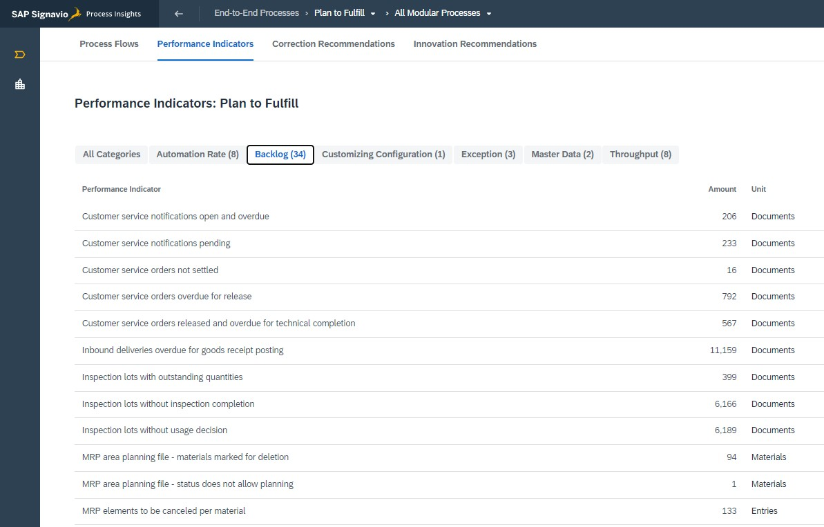
Process monitoring and controlling
SAP Signavio Process Insights performance indicators (Plan to Fulfill)

Slide 82

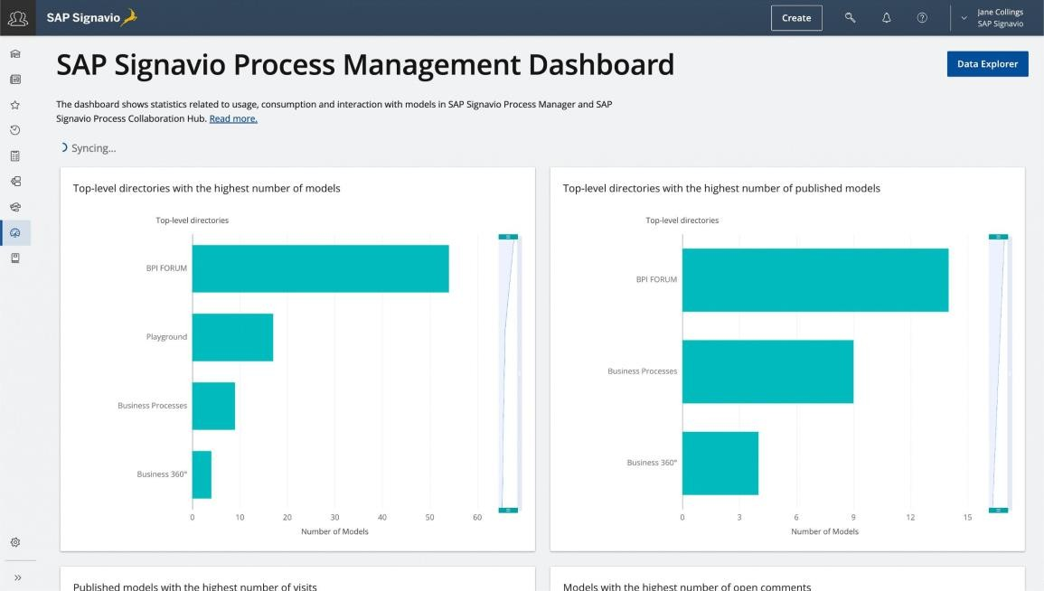
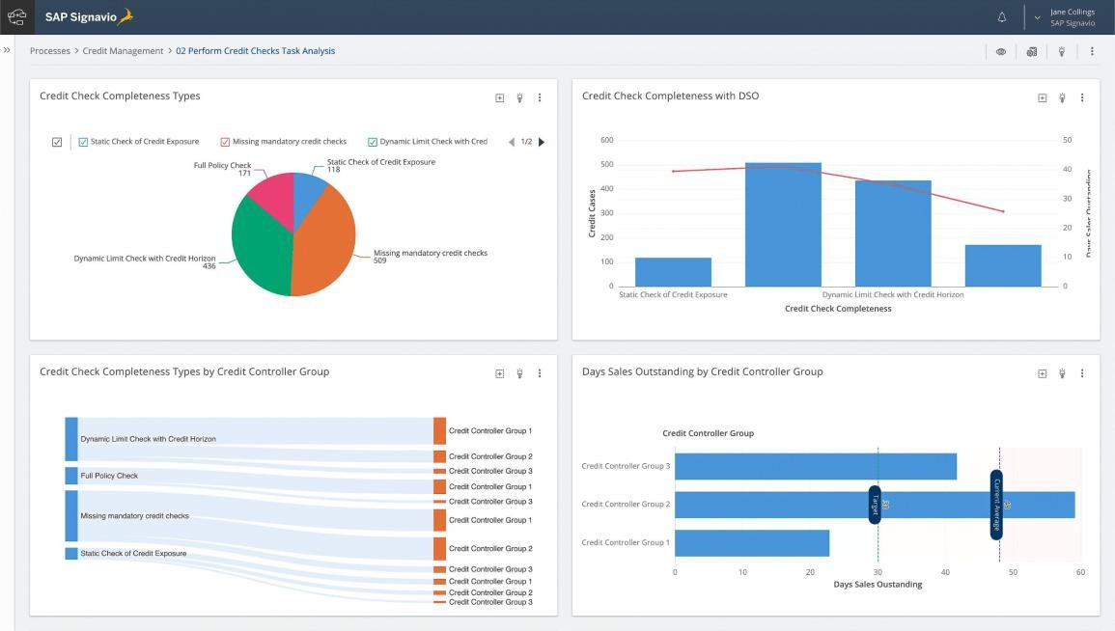
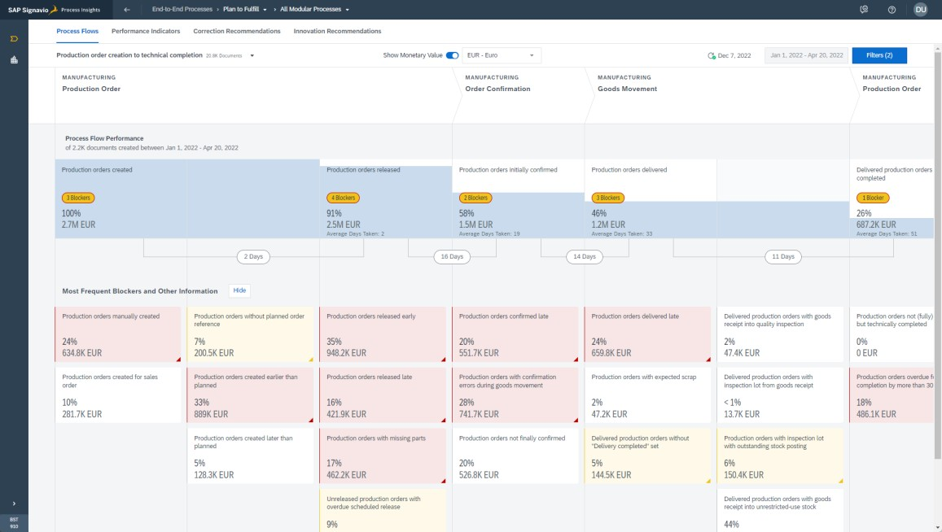
SAP Signavio dashboards
Process monitoring and controlling

Slide 83
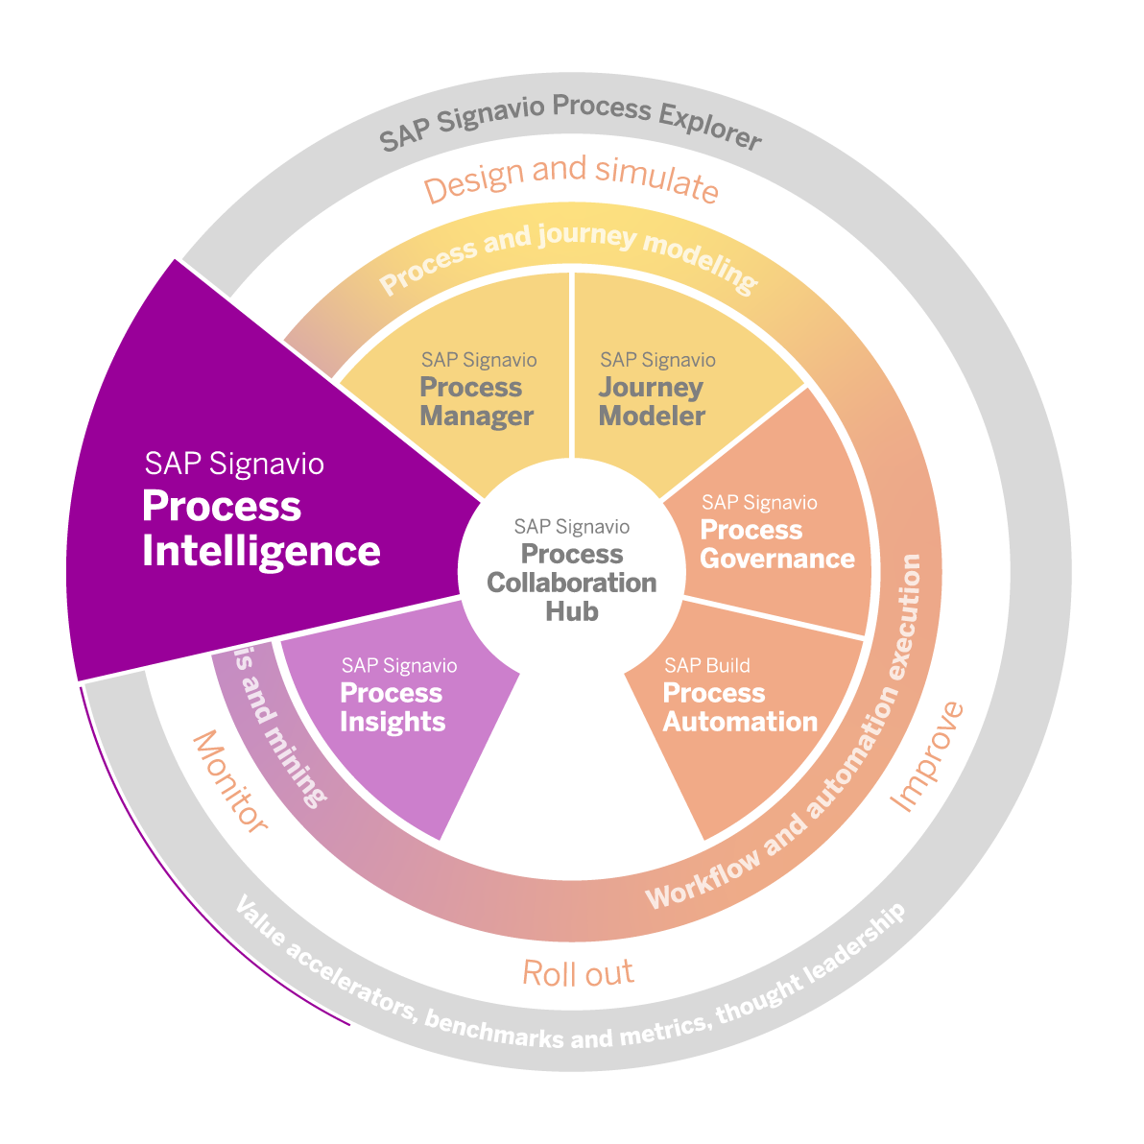
Process monitoring and controlling
SAP Signavio solutions supporting process monitoring and controlling
Process Collaboration Hub
Process Insights
Process Intelligence

Slide 84
Success factors
Process monitoring and controlling
Identify meaninful PPIs to accurately reflect process performance
Establish a continuous improvement mindset
Plan in resources and consider implementation of tools for process monitoring and controlling
Ensure that monitoring focuses on process perfomance only

Slide 85























BTP Business Technology Platform
BTP is a Platform as a service for companies, development teams to design, develop, test, build, package, deploy, monitor and manage end to end business applications.

Slide 89

End Day-2

Slide 90


Do You Have Any Questions

Slide 91


Anubhav Oberoy

Slide 92





We build the workforce of the future.​
We’re committed to empowering you
to be​ the Most Desirable Resource​
through powerful training solutions.​
250+
Corporate Clients
30000+ Learned Trained
25000+ Learned Placed
Enroll Now
www.anubhavtrainings.com
FREE WEBINARS ​
Sign up for free webinars with industry experts every fortnight!

